Slide 1

PHP 8 & Laravel 9
By: Ramy Ibrahim

Slide 2


Outline
PHP Course
Introduction
Programming with PHP
MySQL Database
Implement Online-Store Application with Admin Panel
Publish and Secure PHP Application

Slide 3
Outline
Laravel Course
Introduction to Frameworks and Design Patterns
Laravel Environment and Installation
Database Communication using Laravel
Implement Online-Store Application with Admin Panel
Publish and Secure Laravel Application

Slide 4

PHP 8 Course
Introduction

Slide 5
Web Page Story?
How do you see and interact with web pages?

Slide 6
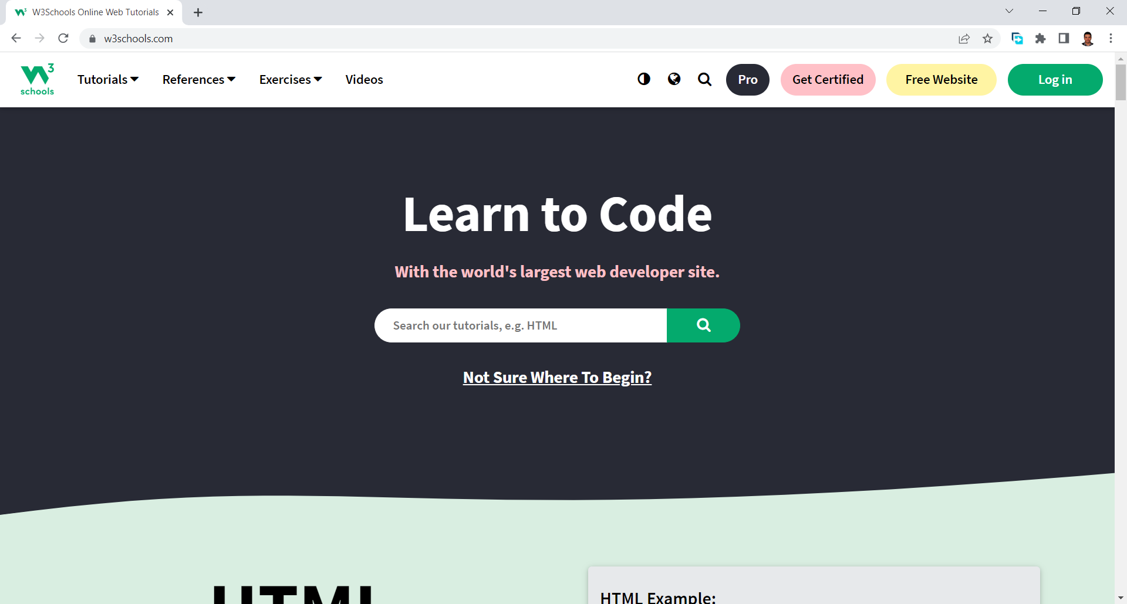


HTTP
HTTP Request and Response
HTTP GET Request
HTTP Response
Web Client
Web Server

Slide 7
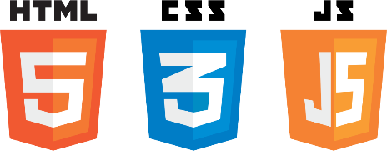
HTTP Request Journey
Internet is a Network
IP Address
Domain Name: www.w3schools.com
IP Address: 76.223.115.82
Domain Name Server
DNS
HTTP GET Request to (76.223.115.82)
Web Client
HTTP Response (200)
Try to Ping
Web Server

Slide 8

Response Journey
Rendering
HTTP GET Request to (76.223.115.82)
Data base server
HTTP Response (200)
Web Server
3rd parties
Web Client
Dynamic Site
Static Site

Slide 9
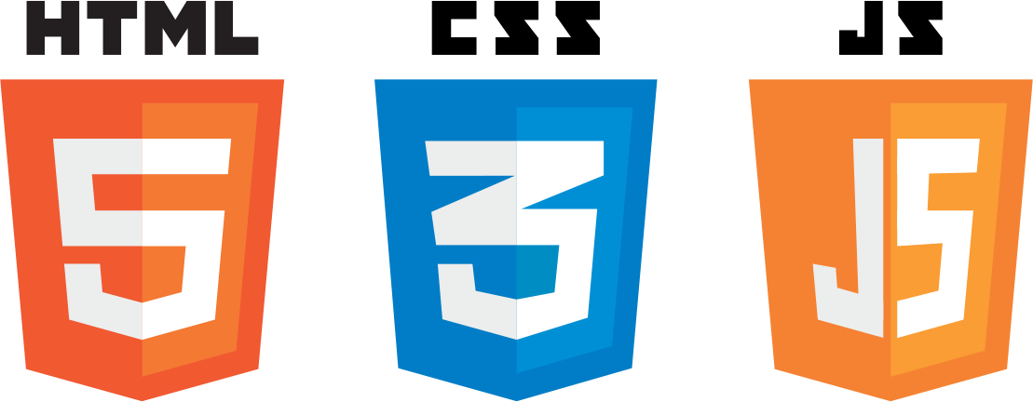
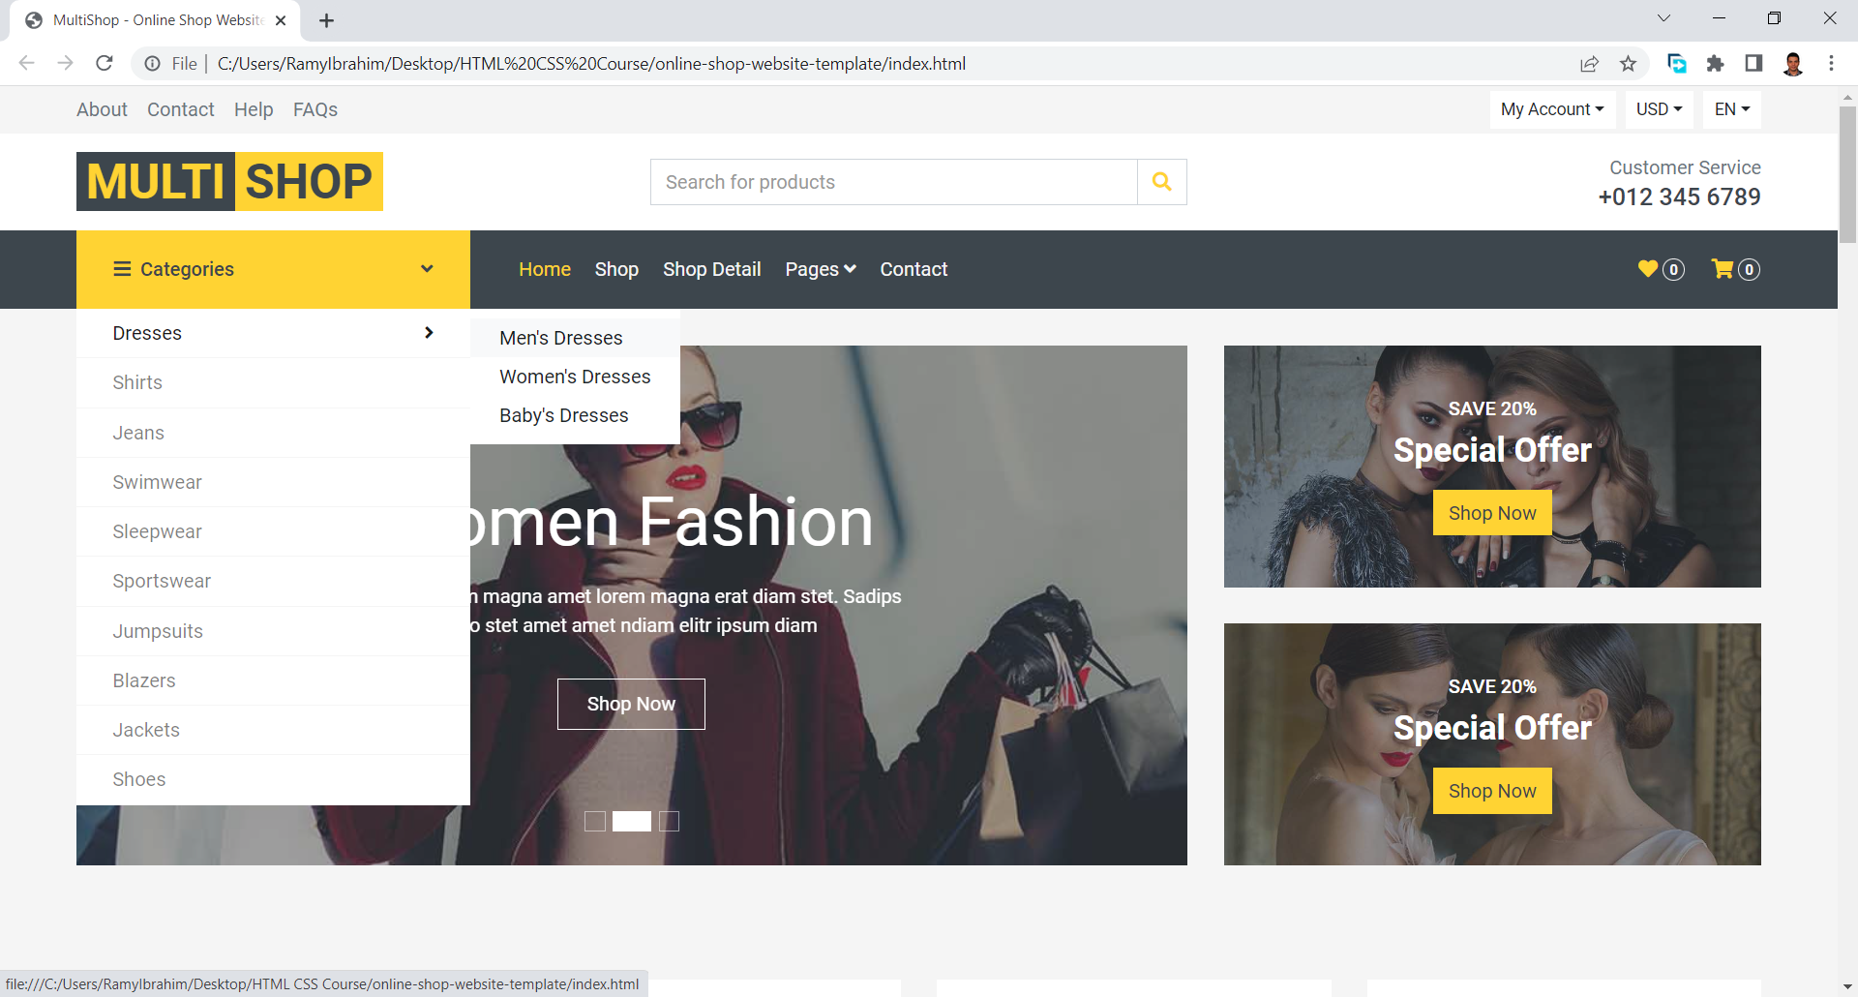

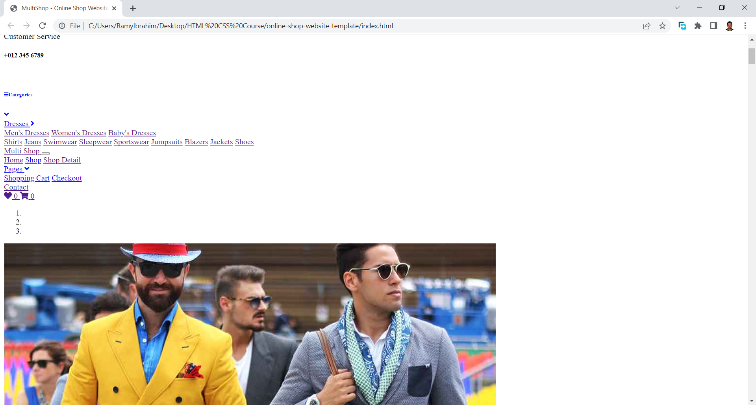
HTML, CSS, and JS
HTML : Content
CSS: Presentation
JS: Actions, Content edit,
Data requests, browser functions
Timers, etc.…

Slide 10
Static vs Dynamic
The use of server-side programming language

Slide 11

Server-side Programming Language
Dynamic data saving and retrieving
Database communication
Data validation
Handling files
Logic layer
Authentication and Authorization
Session
Security and Data Encryption

Slide 12
Embedded code
MVC
API
Front, Back
PHP
JSP
ASP
ASP.net
Laravel
Spring
ASP.net MVC
ASP.net web API
Laravel
Spring
Angular
React
VUE
Web Development Story
Remove Redundancy
Mobile Development
Logic Separation

Slide 13
What is PHP
PHP: Hypertext Preprocessor – Personal Home Page
Open Source
General Purpose and Multi-Paradigm
Dynamic Typed Language
Can be Embedded into HTML
Can output more than HTML (PDF, Flash and other content)
Supports many DBs

Slide 14
PHP Versions
Personal Homepage Tools PHP 1 and 2 (1995 , 1997)
PHP: Hypertext Preprocessor PHP 3 – Engine rewrite (1998)
PHP 4 (2000)
PHP 5 (2005)
PHP 7 (2015), PHP 7.4 Supported till 28 Nov 2022
PHP 8 (2020) , PHP 8.1 (Latest Version) – Supported till 25 Nov 2024

Slide 15
Dev Env
WAMP
LAMP
MAMP
XAMP

Slide 16
Prepare Dev Env
Web server installation

Slide 17
PHP Syntax
<?php ?>
Phpinfo();
Echo
Print

Slide 18
PHP Syntax
<?= ?>
HTML escaping
Comments
Closing tag and accidental white space

Slide 19
Data-types
Primitive types
Null, Bool, Int, Float, String, Array, Object and Resource
Non primitive types
Objects !!

Slide 20
Data-types Example
Let’s write some code

Slide 21
Variables
PHP is a dynamic typed language
Type interfaces are introduced in PHP7
Heap vs Stack in memory
Variables declaration rules:
Starts with: $, a-z, A-Z, _
Contains: a-z, A-Z, _, 0-9
Meaningful names (_ or camelCase)
Super-global variables: $GLOBALSE -$_SESSION,$_COOKIES - $_GET,$_POST,$_REQUEST - $_SERVER - $_ENV - $_FILES

Slide 22
Instance of
$x instance of type (Boolean)
is_object()
gettype()
settype()
isset()
unset()
is_int(), is_float(), is_string(), is_bool()
Casting

Slide 23
Falsely Values
False
0
0.0
-0.0
“0”
[]
“”
Null
All other values are true even (empty resource and NAN)

Slide 24
Simple Debugging
var_dump()
var_export()
die()

Slide 25
Variables
Code example

Slide 26
Operators
Arithmetic
Assignment and Conditional Assignment
Comparison
Logical Operators
String
Array Operators (Will be discussed in array part)
Union (+)
Equality (==,!=,<>)
Identity (===,!==)

Slide 27
Operators
Code example

Slide 28
Conditional Statements
IF
IF ELSE
IF ELSE IF
Switch

Slide 29
Forms
GET: URL params, max character length 2000
POST: Hidden params, can send files using enctype=“multipart/formdata”
Validation (server side)
Using empty() and isset() functions
htmlspecialchars() function

Slide 30
Conditional Statement
Code example using submitted form data

Slide 31
Arrays
Array types:
Indexed
Associative
Multi-dimensional
Array functions
Count
Sort,rsort
Asort,arsort
Ksort,krsort

Slide 32
Loops
For loop
For each of
While
Do while

Slide 33
Loops, Arrays
Code example

Slide 34
Functions
PHP functions are not case-sensitive
PHP has a lot of built-in functions
Optional parameters
Pass by value and pass by reference
Anonymous functions

Slide 35
Functions
Code example

Slide 36
Datetime Functions
strtotime("now")
strtotime("10 September 2000")
strtotime("+1 day")
strtotime("+1 week")
strtotime("+1 week 2 days 4 hours 2 seconds")
strtotime("next Thursday")
strtotime("last Monday")
$time_input = strtotime("2011/05/21");
$date_input = getDate($time_input);

Slide 37
Datetime
Dates in the m/d/y or d-m-y formats are disambiguated by looking at the separator between the various components: if the separator is a slash (/), then the American m/d/y is assumed; whereas if the separator is a dash (-) or a dot (.), then the European d-m-y format is assumed. If, however, the year is given in a two-digit format and the separator is a dash (-), the date string is parsed as y-m-d.
To avoid potential ambiguity, it's best to use ISO 8601 (YYYY-MM-DD) dates or DateTime::createFromFormat() when possible.

Slide 38
Datetime Example
$today = date("F j, Y, g:i a"); // March 10, 2001, 5:16 pm
$today = date("m.d.y"); // 03.10.01
$today = date("j, n, Y"); // 10, 3, 2001
$today = date("Ymd"); // 20010310
$today = date('h-i-s, j-m-y, it is w Day'); // 05-16-18, 10-03-01, 1631 1618 6 Satpm01
$today = date('\i\t \i\s \t\h\e jS \d\a\y.'); // it is the 10th day.
$today = date("D M j G:i:s T Y"); // Sat Mar 10 17:16:18 MST 2001
$today = date('H:m:s \m \i\s\ \m\o\n\t\h'); // 17:03:18 m is month
$today = date("H:i:s"); // 17:16:18
$today = date("Y-m-d H:i:s"); // 2001-03-10 17:16:18 (the MySQL DATETIME format)

Slide 39
Code Organization
What are name spaces?
Include and Require files in PHP
include()
Include_once()
require()
require_once()

Slide 40
OOP
What is Object Oriented Programming
OOP vs Procedural Programming
Procedural programming is about writing procedures or functions that perform operations on the data, while object-oriented programming is about creating objects that contain both data and functions.

Slide 41
OOP Advantages
OOP is faster and easier to execute
OOP provides a clear structure for the programs
OOP helps to keep the PHP code DRY "Don't Repeat Yourself", and makes the code easier to maintain, modify and debug
OOP makes it possible to create full reusable applications with less code and shorter development time

Slide 42
Objects and Classes
Class is a blueprint for Objects
Objects are live instances of Classes that can
Do actions (Methods)
Respond to Changes (Events)
Have Properties (Properties)

Slide 43
OOP Concepts
Encapsulation
Inheritance
Abstraction
Polymorphism

Slide 44
Inheritance
The child class will inherit all the public and protected properties and methods from the parent class. In addition, it can have its own properties and methods.
An inherited class is defined by using the extends keyword.

Slide 45
Encapsulation
Encapsulation protects properties from being altered incorrectly or used incorrectly by accessing them through methods and not directly
Protect from Whom?
Access Modifiers
Public
Private
Protected

Slide 46
Abstraction
Concept
Abstract Classes in PHP
Abstract Classes vs Interfaces

Slide 47
Polymorphism
Concept
Abstract Classes in PHP
Abstract Classes vs Interfaces

Slide 48
Static Classes
Use of Static Classes and Functions
Static Declaration in PHP (C++ Style)

Slide 49
OOP Example
Implement same task using both Procedural Programming and OOP

Slide 50
Handling Files
Access Files on Disk using PHP
Write Files using PHP
Handling File Resource
Handling File Exceptions
Upload Files

Slide 51
File Modes
r: Open a file for read only. File pointer starts at the beginning of the file
w: Open a file for write only. Erases the contents of the file or creates a new file if it doesn't exist. File pointer starts at the beginning of the file
a: Open a file for write only. The existing data in file is preserved. File pointer starts at the end of the file. Creates a new file if the file doesn't exist
x: Creates a new file for write only. Returns FALSE and an error if file already exists

Slide 52
File Modes
r+: Open a file for read/write. File pointer starts at the beginning of the file
w+: Open a file for read/write. Erases the contents of the file or creates a new file if it doesn't exist. File pointer starts at the beginning of the file
a+: Open a file for read/write. The existing data in file is preserved. File pointer starts at the end of the file. Creates a new file if the file doesn't exist
x+: Creates a new file for read/write. Returns FALSE and an error if file already exists

Slide 53
Handling Files
Read and Write files example

Slide 54
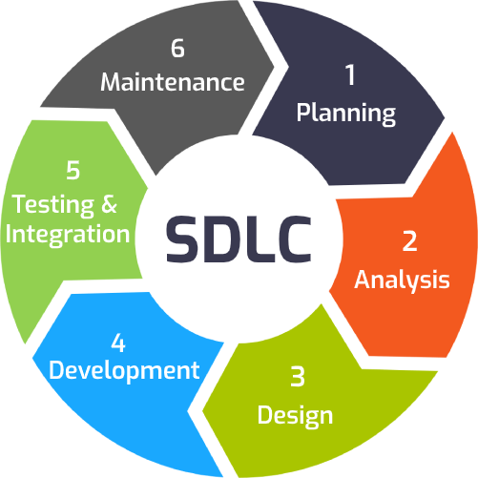
Building Shop Application
Learn about SDLC concepts
What is the difference between modern and Traditional SDLC methodologies?

Slide 55
Database Concepts
What is Database?
What is Database Management System
MySQL DB
Why don’t we use just files?
Spread sheet example

Slide 56
Database Concepts
Data consistency
Data security
Data sharing
Search problem (seek vs search)
Multi-user problem
RDMS
PHPMYADMIN

Slide 57
Database Concepts
ERD
CAP theorem
Relational vs no-SQL database
Data Definition Language (DDL)
Data Manipulation Language (DML)

Slide 58
DB Relations
One – One
One – Many
Many - Many

Slide 59
DDL
Data Definition Language
Use of PHPMyAdmin
CREATE
DROP
RENAME
ALTER.

Slide 60
DML
Data Manipulation Language
Insert
Update
Delete
Select
Where
Group-by
Aggregate functions

Slide 61
MYSQLi and PDO
MySQLi OOP (Improved)
MySQLi Procedural
PDO

Slide 62
Database Example
Create ERD and Database for the Project

Slide 63
CRUD Example
Insert
Get Last Inserted Id
Get Data
Update
Delete

Slide 64
CRUD Example
Create ERD and Database for the Project

Slide 65
Error handling
Types of Errors
Syntax
Logical
Run-time Errors
Try / Catch
Debugging
Handling DB Errors

Slide 66
Error Handling
Error Handling Example

Slide 67
SQL Injections
SQL Injection definition
Prepared Statements
i - integer
d - double
s - string
b - BLOB

Slide 68
SQL Injection
Example for SQL Injection and how to Protect your Data

Slide 69
Multi-tier application
Presentation
Data Access
Logic
Make the application cleaner
Code separation
Introduction to Design Patterns

Slide 70
Make it
Project Example
Single responsibility principle
Make it Object oriented
Make it multi-tier
Make it secure
SQL injection
XSS injection

Slide 71
Sessions and Cookies
Importance of temp data storing
Sessions vs Cookies
Implement Authentication and Authorization

Slide 72
Laravel 9
Next

